Slide 1
Open RAN
Dian Hanifudin Subhi

Slide 2
Outline
Weekly report
Summary of this week’s work
Your work
Conclusion
Your opinion/thought
Action item

Slide 3
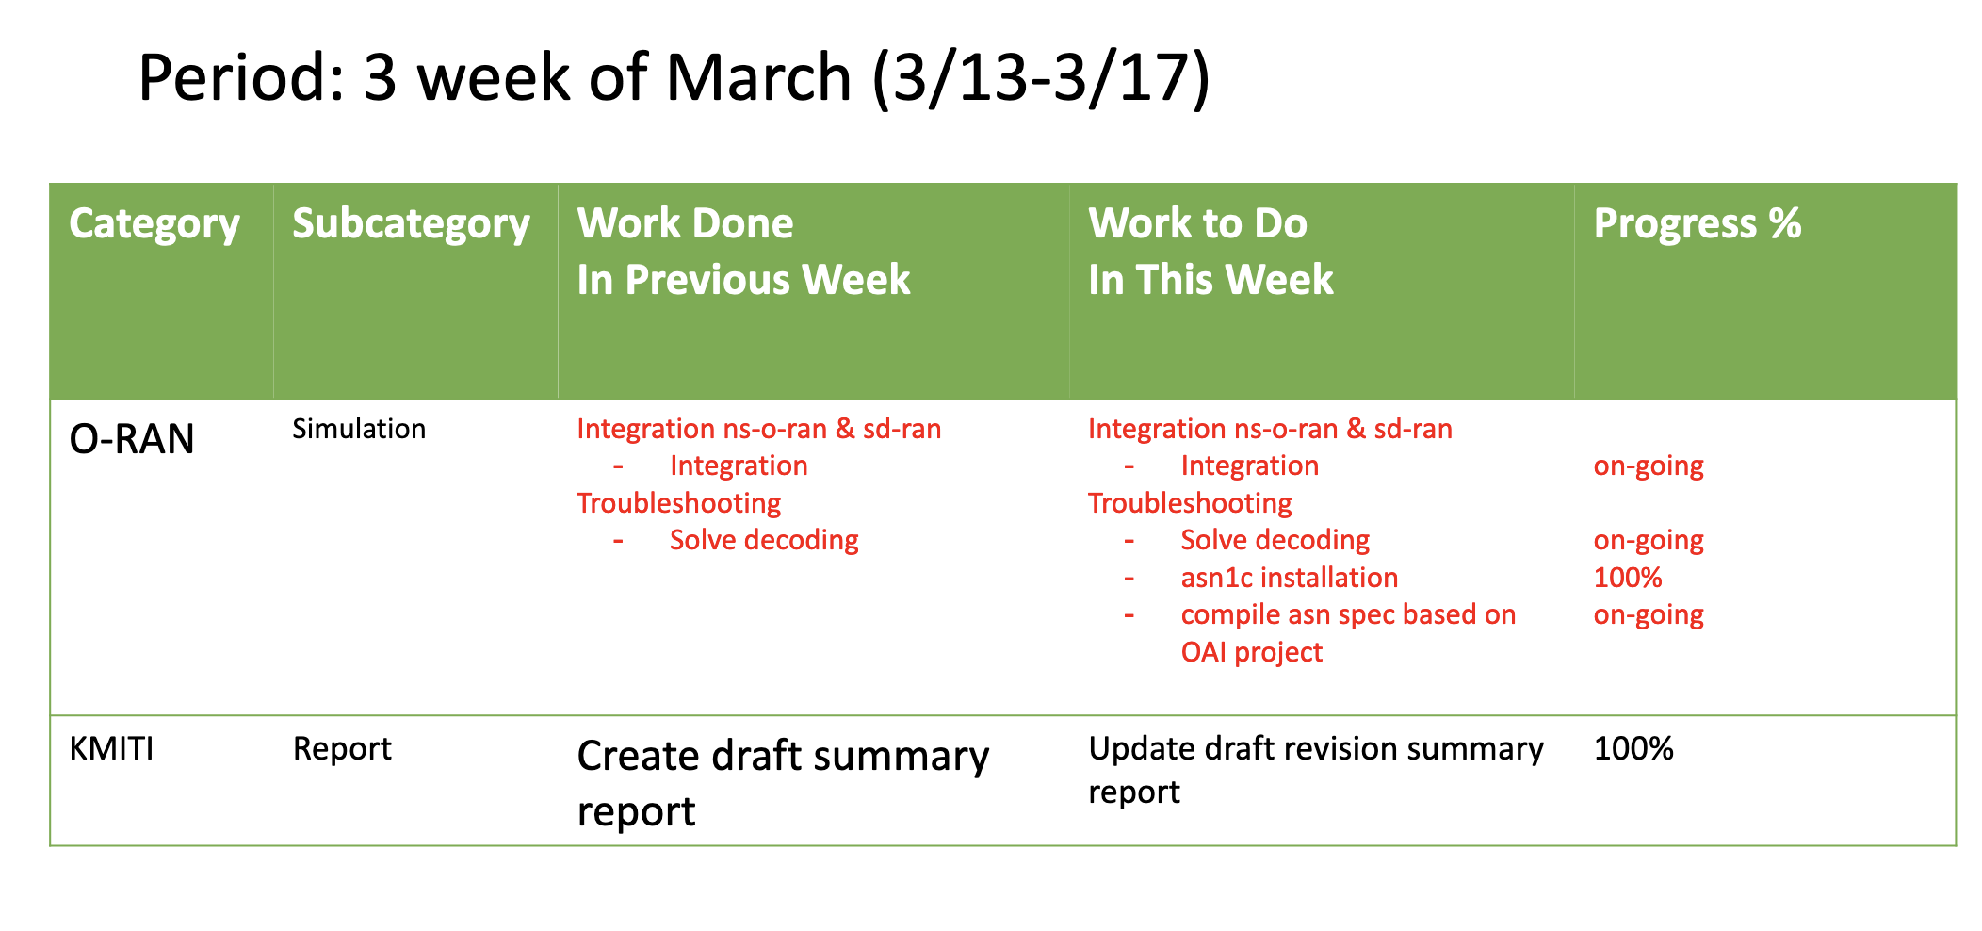
Weekly report

Slide 4
Summary of work this week
Update draft summary report of KMITI
Progress ns-3 integration with SD-RAN

Slide 5
Question to be Answered
How is the progress of ns3 integration with SD-RAN?

Slide 6
Draft report of KMITI
Update summary and future plans
Read interim report from previous report
Create summary and future plans based on the ICGHIT paper and other references

Slide 7
ASN.1
asn1c installation
git clone https://github.com/nokia/asn1c
navigate to asn1c directory
test -f configure || autoreconf -iv
./configure
make
make check
sudo make install

Slide 8
ASN.1
Identify asn and C files
O-RAN define the asn files in https://github.com/o-ran-sc/ric-plt-e2/tree/master/RIC-E2-TERMINATION/3rdparty/asnTextFiles
onos-e2-sm provide the output of asn compilation in servicemodels directory https://github.com/onosproject/onos-e2-sm/tree/master/servicemodels

Slide 9
Compilation
Modify cmakelist
add additional directory to https://github.com/dhanifudin/ns-o-ran-e2-sim/tree/develop/e2sim/src to store .c and .h file
Modify library and targets in CMakeList.txt
Error still exist because undefined member and function
KPM from ns-o-ran-e2-sim project have different member and function with KPM used in onos-e2-sm

Slide 10
Conclusion
Update draft summary report of KMITI
Adjust ASN.1 needed to ensure ns3 and sd-ran using same protocol

Slide 11
Your opinion/thought
Hit and trial is needed to solve encoding/decoding issue

Slide 12
Action items
Adjust compatibility for specific service models one by one (KPM, RC etc)

